Slide 1
CISSP Study Session
Study and become CISSP Certified
We will learn the 10 domains used in the ISC2 and which are tested in the CISSP exam.

Slide 2
Certified Information System Security Professional
Earn the CISSP certification without breaking your wallet

Slide 3
Class Information
Webinars run on Wednesdays
First session from 12:00pm – 1:30pm
Second session from 3:00pm – 4:30pm
Webinars will be uploaded within 24 hours of running

Slide 4
CISSP Short Course
A compressed version of subject
ITE514: Professional Systems Security
Part of the
Master of Information Systems Security
Master of Management (IT)

Slide 5
Master of IS Security
Core Subjects (5 Subjects): ITC596 IT Risk Management ITC593 Network Security ITC506 Topics in IT Ethics ITC595 Information Security ITC597 Digital Forensics ITE512 Incident Response ITE513 Forensic Investigation ITE525 Cyber Law Elective Subjects (Choose 1): ITC516 Principles of Database Development ITC514 Network and Security Administration ITC563 IT Management Issues ITC513 Wireless Networking Concepts | Industry Electives (choose 3) ITE514 Professional Systems Security ITE511 Digital Forensic Security Essentials (Credit only) ITE515 Forensic Analysis (Credit only) ITE516 Hacking Countermeasures ITI551 Virtual Private Network and Firewall Management I (Credit only) MGI511 Project Management Fundamentals MGI512 The Project Lifecycle MGI513 Enterprise Project Management ITI581 Network Security Fundamentals MGI522 Developing Solutions
CISSP certification = credit for 2 subjects
To find out additional credit, fill out Eligibility Form at www.itmasters.edu.au
To contact Charles Sturt University Course Director: jhowarth@csu.edu.au

Slide 6
Market Leader: Distance Ed
Source: DEET

Slide 7
Market leader – IT, PG, Domestic

Slide 8
Information
Dr. Craig S Wright GSE MSTAT LLM GSC GSM MInfoSysSec, MMgmt
Charles Sturt University
Craig.Wright@cscss.org
crwright@csu.edu.au

Slide 9
Overview
Certification review
CISSP requirements
Common Body of Knowledge Areas
Study Suggestions
You will get out of this what you put in.

Slide 10
About this Class
I would like to thank all the authors that have worked to add materials to the Internet that we can all use to educate ourselves inexpensively.
This course is based on many sources of materials and links are provided throughout.

Slide 11
About this Class
In this series of lectures, we will use a variety of free and open source materials and present these in a way that aids you in learning the material and gaining the knowledge needed to pass the exam.
Where possible, all materials and links are available without cost.

Slide 12
Security Principles
The three main security principles also pertain to access control:
Availability
Integrity
Confidentiality

Slide 13
Week 2 - Part 1 Business Continuity Planning (BCP) & Disaster Recovery Planning (DRP)
How to preserve critical business functions in the face of a disaster.

Slide 14
Business Continuity Planning (BCP) & Disaster Recovery Planning (DRP)
http://www.disasterrecovery.org/
https://en.wikipedia.org/wiki/Business_continuity_planning
http://en.wikipedia.org/wiki/Disaster_recovery
http://en.wikipedia.org/wiki/Disaster_recovery_plan
http://www.cio.com/article/40287/Business_Continuity_and_Disaster_Recovery_Planning_Definition_and_Solutions

Slide 15
The BCP domain addresses:
Continuation of critical business processes when a disaster destroys data processing capabilities
Preparation, testing and maintenance of specific actions to recover normal processing (the BCP)
Notes:
1) Note that “disaster” is defined by the business, and may not include actual destruction of capabilities.

Slide 16
Disasters – natural, man-made
Fire, flood, hurricane, tornado, earthquake, volcanoes
Plane crashes, vandalism, terrorism, riots, sabotage, loss of personnel, etc.
Anything that diminishes or destroys normal data processing capabilities

Slide 17
Disasters are defined in terms of the business
If it harms critical business processes, it may be a disaster
Time-based definition – how long can the business stand the pain?
Probability of occurrence
Notes:
Example: a disaster for a small business that depends on its web presence might be an errant backhoe operator cutting a fiber optic line.
Example: Similarly, if the ISP hosting the web site for that business goes out of business and there is no plan to recover, that might be a disaster.
Example: a plane landing on Wagga would be a disaster for CSU

Slide 18
Broad BCP objectives - CIA
Availability – the main focus
Confidentiality – still important
Integrity – still important
Notes:
If you have sensitive or confidential data, your DRP must preserve its confidentiality.
If your DRP doesn’t preserve the integrity of your data, it doesn’t matter if you’ve made it available.

Slide 19
BCP objective
Create, document, test, and update a plan that will:
Allow timely recovery of critical business operations
Minimize loss
Meet legal and regulatory requirements
Notes:
The first two bullets seem obvious, but what about “regulatory requirements?”
If current business practice must meet regulatory requirements (e.g., FERPA, SOX, HIPPA) then the BCP must preserve that compliance. It’s not enough to say “we’re back up!”

Slide 20
Scope of BCP
Used to be just the data center
Now includes:
Distributed operations
Personnel, networks, power
All aspects of the IT environment

Slide 21
Creating a BCP
Is an on-going process, not a project with a beginning and an end
Creating, testing, maintaining, and updating
“Critical” business functions may evolve
The BCP team must include both business and IT personnel
Requires the support of senior management
Notes:
Initial creation of the plan is treated like a project, using traditional project management techniques.
However, business needs change, new processes may be added. If they are “critical,” they must become part of the BCP.
Part of the project to create the BCP must build in business processes for plan maintenance.

Slide 22
The five BCP phases
Project management & initiation
Business Impact Analysis (BIA)
Recovery strategies
Plan design & development
Testing, maintenance, awareness, training
Notes:
Phases are covered in detail in next slides

Slide 23
I - Project management & initiation
Establish need (risk analysis)
Get management support
Establish team (functional, technical, BCC – Business Continuity Coordinator)
Create work plan (scope, goals, methods, timeline)
Initial report to management
Obtain management approval to proceed
Notes:
If you don’t establish need, how can you get management support? A BCP costs a lot to develop and maintain. No ROI either.
Functional leads are necessary because the IT staff don’t understand the business.
The BCC is the project manager for the BCP creation, the most important person.
The work plan will be like the phases of a traditionally managed project

Slide 24
II - Business Impact Analysis (BIA)
Goal: obtain formal agreement with senior management on the MTD for each time-critical business resource
MTD – maximum tolerable downtime, also known as MAO (Maximum Allowable Outage)
Notes:
A lot of the BCP creation is driven by the MTDs assigned to various business functions, so the BIA is very important.

Slide 25
II - Business Impact Analysis (BIA)
Quantifies loss due to business outage (financial, extra cost of recovery, embarassment)
Does not estimate the probability of kinds of incidents, only quantifies the consequences
Notes:
On the second bullet, for instance, the question is not “how likely is it we’ll suffer a total loss of our data center from a fire?” The question is “what would be the loss to the business if we suffered the total loss of our data center?”
Some losses may be quantified fairly exactly. Others have to be estimated as carefully as possible. An example of the latter would the cost to the business in loss of consumer confidence from an extended outage.
For instance, what if CSU were unable to hold classes for four weeks because we couldn’t deliver our electronic instruction? How would parents of potential CSU students react to that? And how much would it cost?

Slide 26
II - BIA phases
Choose information gathering methods (surveys, interviews, software tools)
Select interviewees
Customize questionnaire
Analyze information
Identify time-critical business functions
Notes:
There are nine phases to the BIA.
Selection of interviewees is very important. These will be the subject matter experts from the business units, and they have to be the people who know the business.
Customize questionnaire: there is no standard set of questions – it varies with each business
Time-criticality – some processes are more critical than others. Printing a payroll is important, but not time-critical usually.
if you’re Amazon.com, keeping your web site up is critical. The business won’t go under if you print paychecks a couple of days late, but they would lose millions in potential revenue if their web site were down for a day. The BIA aims to rank-order business processes in these terms.

Slide 27
II - BIA phases (continued)
Assign MTDs
MTD - maximum tolerable downtime
MAO – maximum allowable downtime
Rank critical business functions by MTDs
Report recovery options
Obtain management approval
Notes:
MTD – maximum tolerable downtime
MAO – maximum allowable downtime
Recovery options will range in price and effort – must match them appropriately with the criticality of business functions

Slide 28
III – Recovery strategies
Recovery strategies are based on MTDs
Predefined
Management-approved
Notes:
Predefined means we don’t have to make it up as we go along. We have a documented, tested plan in place.
Management approved means you will get the resources to implement the BCP.

Slide 29
III – Recovery strategies
Different technical strategies
Different costs and benefits
How to choose?
Careful cost-benefit analysis
Driven by business requirements
Notes:
Driven by business requirements means going back to the BIA, which identified critical business processes and ranked them in terms of the MTD/MAO.

Slide 30
III – Recovery strategies
Strategies should address recovery of:
Business operations
Facilities & supplies
Users (workers and end-users)
Network, data center (technical)
Data (off-site backups of data and applications)
Notes:
Business operations were enumerated in the BIA – what IT and other requirements are necessary to support them?
Facilities and supplies – where do I sit at the DR site? Where is my conference room? Do I get a whiteboard? And by the way, I need a pencil.
Users – can manual processes be used as part of DR? If so, how does the manual processing get integrated back into the electronic processing later? Do we need housing, transportation?
Recovery of data centers and networks is an obvious necessity requiring careful planning. There are technical solutions available, though. (Bring money.)
You mean we’ve got all these computers in the DR site and no data? Who forgot the DATA??
I’m only going to go into detail on the last two bullets. The first three are also quite detailed planning processes.

Slide 31
III – Recovery strategies
Technical recovery strategies - scope
Data center
Networks
Telecommunications
Notes:
The data center is obvious.
Network connectivity (loss of) could be defined as a disaster all by itself.
Telecommunications are vital to most businesses. You don’t want to get to the DR site and realize you forgot the need for a PBX or a FAX machine.

Slide 32
III – Recovery strategies
Technical recovery strategies – methods
Subscription services
Mutual aid agreements
Redundant data centers
Service bureaus
Notes:
These four types are covered in subsequent slides

Slide 33
III – Recovery strategies
Technical recovery strategies – subscription service sites
Hot – fully equipped
Warm – missing key components
Cold – empty data center
Mirror – full redundancy
Mobile – trailer full of computers
Notes:
Hot – expensive, testable
Warm – missing key components like computers, hence not testable
Cold – slower to recover, cheaper
Mirror – sounds great if you can afford it
Mobile – the semi tractor-trailer pulls up to your site

Slide 34
III – Recovery strategies
Technical recovery strategies – mutual aid agreements
I’ll help you if you’ll help me!
Inexpensive
Usually not practical
Notes:
Suppose, for instance, that CSU can’t afford a hot DR site and neither can CQU. We agree to help each other in this case.
But we probably don’t have identical hardware and software at both institutions.
Most likely neither institution has excess capacity to make available in a DR scenario
Does this sound like it’s going to work? It is probably better than nothing, though.

Slide 35
III – Recovery strategies
Technical recovery strategies – redundant processing centers
Expensive
Maybe not enough spare capacity for critical operations
Notes:
Think of load balanced redundant sites, for instance. Operations are going OK, but are both sites running at less than 50% capacity? Can site A handle the load if site B goes down?

Slide 36
III – Recovery strategies
Technical recovery strategies –service bureaus
Many clients share facilities
Almost as expensive as a hot site
Must negotiate agreements with other clients
Notes:
The claim in the (ISC)2 book is that service bureaus are shared by many clients and usually run at about 100% capacity. If a client has to transfer operations to the service bureau as part of a DR, the other clients take a hit in diminished processing capacity. Agreements need to be negotiated in advance with the other clients.

Slide 37
III – Recovery strategies
Technical recovery strategies –data
Backups of data and applications
Off-site vs. on-site storage of media
How fast can data be recovered?
How much data can you lose?
Security of off-site backup media
Types of backups (full, incremental, differential, etc.)
Notes:
Full backups are what you think they are – everything.
Incremental backups are files changed since *previous* backup, which might be a full backup or an incremental. Potentially a long recovery period.
Differential backups are all files changed since previous full backup – quicker recovery.
Continuous backups – like a journal file system, or like Oracle’s Dataguard hot spare environment. Geographically separated systems are kept up to date in real time.

Slide 38
IV – BCP development / implementation
Detailed plan for recovery
Business & service recovery plans
Maintenance
Awareness & training
Testing
Notes:
Step one above is what you might think of as the BCP, but the next 3 bullets are equally important.

Slide 39
IV – BCP development / implementation
Sample plan phases
Initial disaster response
Resume critical business ops
Resume non-critical business ops
Restoration (return to primary site)
Interacting with external groups (customers, media, emergency responders)
Notes:
Plan phases – i.e., what would happen if a disaster occurred.
The last phase, interacting with external entities, may actually begin immediately, probably with the decision that a disaster has occurred and the business is going to implement the BCP. An initial communication may be out to stakeholders at that point.

Slide 40
V – BCP final phase
Testing
Maintenance
Awareness
Training

Slide 41
V – BCP final phase - testing
Until it’s tested, you don’t have a plan
Kinds of testing
Structured walk-through
Checklist
Simulation
Parallel
Full interruption
Notes:
Structured walk-through – step-by-step review of the BCP by functional reps who meet together – no one is actually walking anywhere
Checklist – similar to SWT but checklists are distributed to business units, who review the checklists individually
Simulation – kind of like “war games” – simulation stops at point where equipment would be relocated
Parallel – DR site is put into full operation without taking down the primary – results compared between the two
Full interruption – Full-scale test of BCP by a planned fail-over to the secondary site and fail-back to the primary. Risky.
Note: more than one kind of test may be useful. For instance, a simulation and a parallel test complement each other.

Slide 42
V – BCP final phase - maintenance
Fix problems found in testing
Implement change management
Audit and address audit findings
Annual review of plan
Build plan into organization

Slide 43
V – BCP final phase - training
BCP team is probably the DR team
BCP training must be on-going
BCP training needs to be part of the standard on-boarding and part of the corporate culture
Notes:
How often do disasters occur?
How good are people at executing procedures that they don’t use very often?
How do you ensure something is part of the corporate culture when it’s designed to deal with an event we hope never happens?

Slide 44
More reading
GIAC white papers for the CISSP CBK
http://www.giac.org/resources/whitepaper/application/
Notes:
All references are from All in One Book (Shon Harris, 2005)
The danger of insiders is that they have already been given a wide range of access that a hacker would have to work to obtain, they probably have intimate knowledge of the environment, and generally they are trusted. (214)
Dictionary Attack: This type of program is fed lists (dictionaries) of commonly used words or combinations of characters and then compares these values to capture passwords. (214)
Most operating systems and applications put passwords through hashing algorithms, which result in hash values, also referred to as message digest values. (215)
Countermeasures for dictionary and other password attacks: (215)
Do not allow passwords to be sent in cleartext
Encrypt the passwords with encryption algorithms or hashing functions
Employ one time password tokens
Use hard to guess passwords
Rotate passwords frequently
Employ an IDS to detect suspicious behavior
Use dictionary cracking tools to find weak passwords chosen by users
Use special characters, numbers, and upper and lower case letters within the password
Protect password files.
Brute Force Attack: Generally speaking these are attacks that continually try different inputs to achieve a predefined goal. (i.e., trying every possible combination until the correct one is identified.) (215)
The most effective way to uncover passwords is through a hybrid attack, which combines a dictionary attack and a brute force attack. (215)
Wardialing Attacks: Inserting long lists of phone numbers into a wardialing program in hopes of finding a model that can be exploited to gain unauthorized access. (216)
Countermeasures for a brute force attack: (216)
Perform brute force attacks to find weaknesses and hanging modems
Make sure only necessary phone numbers are made public
Provide stringent access control methods that would make brute force attacks less successful
Monitor and audit for such activity
Employ an IDS to watch for suspicious activity
Set lock)
Lockout thresholds.
Spoofing at Logon: An attacker can use a program that presents to the user a fake logon screen, which often tricks the user into attempting to logon. (216)
This has become a common attack on the Internet in phishing attacks and identity theft attempts. (216)
Countermeasures (217)
Guaranteed trusted path: A communication link between the user and the kernel that cannot be circumvented as described in the scenario of a fake logon screen. (217)
Be skeptical of emails asking you to change/confirm/check accounts
Call the legitimate company regarding the message
Review the address bar to see if the domain name is correct
Looks for SSL connection when submitting financial information or credential data
do not click on embedded links
Do not accept email in HTML format.

Slide 45
Question and answer
?

Slide 46
Week 2 - Part 2 Cryptography
Refers to the controls that are included within systems and applications software and the steps used in their development. - Systems development life cycle (SDLC) - Application environment and security controls - Effectiveness of application security

Slide 47
Cryptography
http://en.wikipedia.org/wiki/Cryptography
http://www.garykessler.net/library/crypto.html
http://www.youtube.com/watch?v=5BVehsUS7Y4
http://www.virtualschool.edu/mon/Crypto/index.html

Slide 48
General Idea
Cryptography – the idea of storing and transmitting data in a form that only the authorized parties can interpret.

Slide 49
Outline
History
Terms & Definitions
Symmetric and Asymmetric Algorithms
Hashing
PKI Concepts
Attacks on Cryptosystems

Slide 50
Introduction
“Hidden writing”
Increasingly used to protect information
Can ensure confidentiality
Integrity and Authenticity too
Notes:
Cryptography – Greek for hidden and writing is a means of transforming data in a way that renders it unreadable by anyone except the intended recipient.
What was originally used almost exclusively by governments for espionage has become a powerful tool for personal privacy today. Every modern computer system uses modern cryptographic methods to secure passwords stored and provides the trusted backbone for e-commerce (think lock icon).
Cryptography fits into the CIA triad, as it can be used to ensure confidentiality and integrity of a message. Some forms also provide for sender authenticity and proof of delivery. But cryptography doesn’t address availability as some other forms of security do. Although forgetting a password for your user account can certainly lead to a denial of service attack. However, cryptography is used in many access control systems

Slide 51
History – The Manual Era
Dates back to at least 2000 B.C.
Pen and Paper Cryptography
Examples
Scytale
Atbash
Caesar
Vigenère
Notes:
The history of cryptography begins where many stories of history do…. in ancient Egypt with hieroglyphics.
Scytale – Spartan method involved wrapping a belt around a rod of a given diameter and length
Atbash – Hewbrew cipher which mirrored the normal alphabet (shown in The DaVinci Code)
Caesar – Shift all letters by a given number of letters in the alphabet
Vignère – Use of a key and multiple alphabets to hide repeated characters in an encrypted message

Slide 52
History – The Mechanical Era
Invention of cipher machines
Examples
Confederate Army’s Cipher Disk
Japanese Red and Purple Machines
German Enigma
Notes:
The history of cryptography begins where many old tales do…. in ancient Egypt with hieroglyphics. These were not meant to hide messages so much as to give a formal and ceremonial touch to stories of everyday events.
During the industrial age, cryptography was moved from a manual exercise to one done by machines. The invention of cipher disks and rotors for this use allowed for the creation of much more complex algorithms.

Slide 53
History – The Modern Era
Computers!
Examples
Lucifer
Rijndael
RSA
ElGamal
Notes:
Modern computing gave cryptographers vast resources for improving the complexity of cryptosystems as well as for attacking them. And with the spread of personal computing, electronic commerce, and personal privacy concerns, use of encryption has spread beyond its traditional uses in military and government applications.

Slide 54
Speak Like a Crypto Geek
Plaintext – A message in its natural format readable by an attacker
Ciphertext – Message altered to be unreadable by anyone except the intended recipients
Key – Sequence that controls the operation and behavior of the cryptographic algorithm
Keyspace – Total number of possible values of keys in a crypto algorithm
Notes:
Just like with many technical topics, Cryptography has its own lingo. Learning and using these terms and their definitions are the key to speaking like a crypto geek.

Slide 55
Speak Like a Crypto Geek (2)
Initialization Vector – Random values used with ciphers to ensure no patterns are created during encryption
Cryptosystem – The combination of algorithm, key, and key management functions used to perform cryptographic operations

Slide 56
Cryptosystem Services
Confidentiality
Integrity
Authenticity
Nonrepudiation
Access Control
Notes:
So why do care about cryptography? Well, here’s what it can do for us.
Confidentiality – Only authorized entities are allowed to view
Integrity – Ensures the message was not altered by unauthorized individuals
Authenticity – Validates the source of a message, to ensure the sender is properly identified
Nonrepudiation – Establishes sender identity so that the entity cannot deny having sent the message
Access Control – Access to an object requires access to the associated crypto keys in many systems (e.g. login)

Slide 57
Types of Cryptography
Stream-based Ciphers
One at a time, please
Mixes plaintext with key stream
Good for real-time services
Block Ciphers
Amusement Park Ride
Substitution and transposition
Notes:
Stream Ciphers are fast and easy to implement in hardware.
Block ciphers are stronger, but slower and often implemented in hardware.

Slide 58
Encryption Systems
Substitution Cipher
Convert one letter to another
Cryptoquip
Transposition Cipher
Change position of letter in text
Word Jumble
Monoalphabetic Cipher
Caesar
Notes:
Substitution Cipher: Replacing one letter with another
Transposition Cipher: World Jumble. Rearranging or reordering the letters within a message
Monoalphabetic Cipher: Algorithm that substitutes one letter in the ciphertext alphabet for one in the plaintext alphabet

Slide 59
Encryption Systems
Polyalphabetic Cipher
Vigenère
Modular Mathematics
Running Key Cipher
One-time Pads
Randomly generated keys
59
Notes:
Polyalphabetic Cipher: Algorithm that substitutes a letter from two or more ciphertext alphabets for each plaintext alphabet letter based on position in the message.
Modular Mathemaitcs: Sometimes referred to as “clock arithmetic”, computes operations over a given range of values from 0 to N. Referred to as modulo N.
One-time Pads: Offer perfect secrecy if a true source of randomness is used, but is very difficult to use in practice.
59

Slide 60
Steganography
Hiding a message within another medium, such as an image
No key is required
Example
Modify color map of JPEG image
Notes:
Invisible ink, hidden tattoos, and microdots are all examples of steganography.
By taking a color digital image and slightly altering the color of each pixel, you can hide a message in the image without noticeably altering the appearance. The receiver can then extract the message if they have the original, unaltered image.

Slide 61
Cryptographic Methods
Symmetric
Same key for encryption and decryption
Key distribution problem
Asymmetric
Mathematically related key pairs for encryption and decryption
Public and private keys
Notes:
Cryptographic Algorithms generally fall into one of two different categories, or are a combination of both.
Symmetric
Fast
Only provide confidentiality
Need secure channel for key distribution
Key management headaches from large number of key pairs to maintain N(N-1)/2
That’s over 6.3 million key pairs to let all 3556 Purdue A/P staff members exchange encrypted messages
To do the same for all students would require over half a billion key pairs!
Examples: DES, AES, Blowfish, RC4, RC5
Asymmetric
Large mathematical operations make it slower than symmetric algorithms
No need for out of band key distribution (public keys are public!)
Scales better since only a single key pair needed per individual
Can provide authentication and nonrepudiation
Examples: RSA, El Gamal, ECC, Diffie-Hellman

Slide 62
Cryptographic Methods
Hybrid
Combines strengths of both methods
Asymmetric distributes symmetric key
Also known as a session key
Symmetric provides bulk encryption
Example:
SSL negotiates a hybrid method
Notes:
A hybrid cryptosystem is the best of both worlds. In this case, an asymmetric encryption scheme is used to transmit a generated symmetric key to the other party, then that key is used for all further communications.
This combines the scalability and key management features of the asymmetric algorithms with the speed of symmetric ones. The Secure Sockets Layer (SSL) protocol negotiates which asymmetric and symmetric algorithms to use in a hybrid system to protect TCP connections, such as an HTTP connection between a web browser and web server.

Slide 63
Attributes of Strong Encryption
Confusion
Change key values each round
Performed through substitution
Complicates plaintext/key relationship
Diffusion
Change location of plaintext in ciphertext
Done through transposition
Notes:
Strong encryption uses a combination of both of these attributes to attain a sufficiently complex algorithm.

Slide 64
Message Authentication Codes
Small block of data generated with a secret key and appended to a message
HMAC (RFC 2104)
Uses hash instead of cipher for speed
Used in SSL/TLS and IPSec
Notes:
Traditional MAC is generated using DES-CBC and is just the last block of ciphertext created when encrypting the message itself. This can be appended to the plaintext to be used as a MAC. Unfortunately, DES and other encryption mechanisms can be somewhat slow compared to a hash function.
So the HMAC standard was created which allows using a hash algorithm with a secret key “mixed in” to improve the speed while providing message integrity and authentication.

Slide 65
Digital Signatures
Hash of message encrypted with private key
Digital Signature Standard (DSS)
DSA/RSA/ECD-SA plus SHA
DSS provides
Sender authentication
Verification of message integrity
Nonrepudiation
Notes:
The hash is encrypted instead of the message itself for performance reasons. Encrypting a large document with a private key is a much more time consuming process than taking the hash of the same message and then encrypting that hash.
The Digital Signature Standard (DSS) includes the following asymmetric key and message digest algorithms.
Digital Signature Algorithm (DSA)
RSA
Elliptic Curve Distribution (Signature Algorithm)
SHA (Message Digest)
DSS is a US government standard and is used in e-commerce, e-mail, and financial transactions on a daily basis.

Slide 66
Cryptanalysis
Kerckhoff’s Principle
The only secrecy involved with a cryptosystem should be the key
Cryptosystem Strength
How hard is it to determine the secret associated with the system?

Slide 67
Cryptanalysis Attacks
Brute force
Trying all key values in the keyspace
Frequency Analysis
Guess values based on frequency of occurrence
Dictionary Attack
Find plaintext based on common words

Slide 68
Cryptanalysis Attacks
Replay Attack
Repeating previous known values
Factoring Attacks
Find keys through prime factorization
Ciphertext-Only
Known Plaintext
Format or content of plaintext available

Slide 69
Cryptanalysis Attacks
Chosen Plaintext
Attack can encrypt chosen plaintext
Chosen Ciphertext
Decrypt known ciphertext to discover key
Differential Power Analysis
Side Channel Attack
Identify algorithm and key length

Slide 70
Cryptanalysis Attacks
Social Engineering
Humans are the weakest link
RNG Attack
Predict IV used by an algorithm
Temporary Files
May contain plaintext

Slide 71
E-mail Security Protocols
Privacy Enhanced Email (PEM)
Pretty Good Privacy (PGP)
Based on a distributed trust model
Each user generates a key pair
S/MIME
Requires public key infrastructure
Supported by most e-mail clients
Notes:
PEM
First in the field, but never really caught on and was superseded by others such as S/MIME
Generally had too strict of PKI requirements to be feasible for many organizations.
PGP
Uses a “web of trust” distributed trust model where each user is an authority
Key revocation is difficult due to the distributed nature of the web
Originally designed by Phil Zimmerman and released in 1991
S/MIME
Secure Multipurpose Internet Mail Extension
Standard for encrypting and signing electronic mail which extends the MIME standard
Uses X.509 certificates

Slide 72
Network Security
Link Encryption
Encrypt traffic headers + data
Transparent to users
End-to-End Encryption
Encrypts application layer data only
Network devices need not be aware
Notes:
Link Encryption involves performing encryption at the physical or data link layers of the OSI network model to protect confidentiality of information within the communications channel only. The link routing information itself is encrypted and must be decrypted by each device along the channel to determine the next receiver, then re-encrypted when transmitted. Link encryption can thwart attempts at traffic analysis, although it is typically costly due to the need to have specialized routing equipment along the path. The users, however, can be blissfully ignorant of the details of the encryption involved. Satellite TV is an example of a medium that uses link encryption.
End-to-end encryption, however, only encrypts the application layer data being transmitted. Network devices can be “dumb” with regard to the encryption used, while users may have more flexibility in selecting the algorithms. Because only the data is protected in transit, E2E encryption doesn’t enjoy the same resistance to traffic analysis as link encryption.

Slide 73
Network Security
SSL/TLS
Supports mutual authentication
Secures a number of popular network services
IPSec
Security extensions for TCP/IP protocols
Supports encryption and authentication
Used for VPNs

Slide 74
History – The Manual Era
Dates back to at least 2000 B.C.
Pen and Paper Cryptography
Examples
Scytale
Atbash
Caesar
Vigenère
Notes:
The history of cryptography begins where many stories of history do…. in ancient Egypt with hieroglyphics.
Scytale – Spartan method involved wrapping a belt around a rod of a given diameter and length
Atbash – Hewbrew cipher which mirrored the normal alphabet (shown in The DaVinci Code)
Caesar – Shift all letters by a given number of letters in the alphabet
Vignère – Use of a key and multiple alphabets to hide repeated characters in an encrypted message

Slide 75
History – The Mechanical Era
Invention of cipher machines
Examples
Confederate Army’s Cipher Disk
Japanese Red and Purple Machines
German Enigma
Notes:
The history of cryptography begins where many old tales do…. in ancient Egypt with hieroglyphics. These were not meant to hide messages so much as to give a formal and ceremonial touch to stories of everyday events.
During the industrial age, cryptography was moved from a manual exercise to one done by machines. The invention of cipher disks and rotors for this use allowed for the creation of much more complex algorithms.

Slide 76
History – The Modern Era
Computers!
Examples
Lucifer
Rijndael
RSA
ElGamal
Notes:
Modern computing gave cryptographers vast resources for improving the complexity of cryptosystems as well as for attacking them. And with the spread of personal computing, electronic commerce, and personal privacy concerns, use of encryption has spread beyond its traditional uses in military and government applications.

Slide 77
Speak Like a Crypto Geek
Plaintext – A message in its natural format readable by an attacker
Ciphertext – Message altered to be unreadable by anyone except the intended recipients
Key – Sequence that controls the operation and behavior of the cryptographic algorithm
Keyspace – Total number of possible values of keys in a crypto algorithm
Notes:
Just like with many technical topics, Cryptography has its own lingo. Learning and using these terms and their definitions are the key to speaking like a crypto geek.

Slide 78
Speak Like a Crypto Geek
Initialization Vector – Random values used with ciphers to ensure no patterns are created during encryption
Cryptosystem – The combination of algorithm, key, and key management functions used to perform cryptographic operations

Slide 79
Cryptosystem Services
Confidentiality
Integrity
Authenticity
Nonrepudiation
Access Control
Notes:
So why do care about cryptography? Well, here’s what it can do for us.
Confidentiality – Only authorized entities are allowed to view
Integrity – Ensures the message was not altered by unauthorized individuals
Authenticity – Validates the source of a message, to ensure the sender is properly identified
Nonrepudiation – Establishes sender identity so that the entity cannot deny having sent the message
Access Control – Access to an object requires access to the associated crypto keys in many systems (e.g. login)

Slide 80
Types of Cryptography
Stream-based Ciphers
One at a time, please
Mixes plaintext with key stream
Good for real-time services
Block Ciphers
Amusement Park Ride
Substitution and transposition
Notes:
Stream Ciphers are fast and easy to implement in hardware.
Block ciphers are stronger, but slower and often implemented in hardware.

Slide 81
Cryptographic Methods
Symmetric
Same key for encryption and decryption
Key distribution problem
Asymmetric
Mathematically related key pairs for encryption and decryption
Public and private keys
Notes:
Cryptographic Algorithms generally fall into one of two different categories, or are a combination of both.
Symmetric
Fast
Only provide confidentiality
Need secure channel for key distribution
Key management headaches from large number of key pairs to maintain N(N-1)/2
That’s over 6.3 million key pairs to let all 3556 Purdue A/P staff members exchange encrypted messages
To do the same for all students would require over half a billion key pairs!
Examples: DES, AES, Blowfish, RC4, RC5
Asymmetric
Large mathematical operations make it slower than symmetric algorithms
No need for out of band key distribution (public keys are public!)
Scales better since only a single key pair needed per individual
Can provide authentication and nonrepudiation
Examples: RSA, El Gamal, ECC, Diffie-Hellman

Slide 82
Cryptographic Methods
Hybrid
Combines strengths of both methods
Asymmetric distributes symmetric key
Also known as a session key
Symmetric provides bulk encryption
Example:
SSL negotiates a hybrid method
Notes:
A hybrid cryptosystem is the best of both worlds. In this case, an asymmetric encryption scheme is used to transmit a generated symmetric key to the other party, then that key is used for all further communications.
This combines the scalability and key management features of the asymmetric algorithms with the speed of symmetric ones. The Secure Sockets Layer (SSL) protocol negotiates which asymmetric and symmetric algorithms to use in a hybrid system to protect TCP connections, such as an HTTP connection between a web browser and web server.

Slide 83
Birthday Attack
Collisions
Two messages with the same hash value
Based on the “birthday paradox”
Hash algorithms should be resistant to this attack
http://en.wikipedia.org/wiki/Birthday_attack

Slide 84
Message Authentication Codes
Small block of data generated with a secret key and appended to a message
HMAC (RFC 2104)
Uses hash instead of cipher for speed
Used in SSL/TLS and IPSec
Notes:
Traditional MAC is generated using DES-CBC and is just the last block of ciphertext created when encrypting the message itself. This can be appended to the plaintext to be used as a MAC. Unfortunately, DES and other encryption mechanisms can be somewhat slow compared to a hash function.
So the HMAC standard was created which allows using a hash algorithm with a secret key “mixed in” to improve the speed while providing message integrity and authentication.

Slide 85
Digital Signatures
Hash of message encrypted with private key
Digital Signature Standard (DSS)
DSA/RSA/ECD-SA plus SHA
DSS provides
Sender authentication
Verification of message integrity
Nonrepudiation
Notes:
The hash is encrypted instead of the message itself for performance reasons. Encrypting a large document with a private key is a much more time consuming process than taking the hash of the same message and then encrypting that hash.
The Digital Signature Standard (DSS) includes the following asymmetric key and message digest algorithms.
Digital Signature Algorithm (DSA)
RSA
Elliptic Curve Distribution (Signature Algorithm)
SHA (Message Digest)
DSS is a US government standard and is used in e-commerce, e-mail, and financial transactions on a daily basis.

Slide 86
Cryptanalysis
The study of methods to break cryptosystems
Often targeted at obtaining a key
Attacks may be passive or active

Slide 87
Cryptanalysis
Kerckhoff’s Principle
The only secrecy involved with a cryptosystem should be the key
Cryptosystem Strength
How hard is it to determine the secret associated with the system?

Slide 88
Cryptanalysis Attacks
Brute force
Trying all key values in the keyspace
Frequency Analysis
Guess values based on frequency of occurrence
Dictionary Attack
Find plaintext based on common words

Slide 89
Cryptanalysis Attacks
Replay Attack
Repeating previous known values
Factoring Attacks
Find keys through prime factorization
Ciphertext-Only
Known Plaintext
Format or content of plaintext available

Slide 90
Cryptanalysis Attacks
Chosen Plaintext
Attack can encrypt chosen plaintext
Chosen Ciphertext
Decrypt known ciphertext to discover key
Differential Power Analysis
Side Channel Attack
Identify algorithm and key length

Slide 91
Cryptanalysis Attacks
Social Engineering
Humans are the weakest link
RNG Attack
Predict IV used by an algorithm
Temporary Files
May contain plaintext

Slide 92
E-mail Security Protocols
Privacy Enhanced Email (PEM)
Pretty Good Privacy (PGP)
Based on a distributed trust model
Each user generates a key pair
S/MIME
Requires public key infrastructure
Supported by most e-mail clients
Notes:
PEM
First in the field, but never really caught on and was superseded by others such as S/MIME
Generally had too strict of PKI requirements to be feasible for many organizations.
PGP
Uses a “web of trust” distributed trust model where each user is an authority
Key revocation is difficult due to the distributed nature of the web
Originally designed by Phil Zimmerman and released in 1991
S/MIME
Secure Multipurpose Internet Mail Extension
Standard for encrypting and signing electronic mail which extends the MIME standard
Uses X.509 certificates

Slide 93
Network Security
Link Encryption
Encrypt traffic headers + data
Transparent to users
End-to-End Encryption
Encrypts application layer data only
Network devices need not be aware
Notes:
Link Encryption involves performing encryption at the physical or data link layers of the OSI network model to protect confidentiality of information within the communications channel only. The link routing information itself is encrypted and must be decrypted by each device along the channel to determine the next receiver, then re-encrypted when transmitted. Link encryption can thwart attempts at traffic analysis, although it is typically costly due to the need to have specialized routing equipment along the path. The users, however, can be blissfully ignorant of the details of the encryption involved. Satellite TV is an example of a medium that uses link encryption.
End-to-end encryption, however, only encrypts the application layer data being transmitted. Network devices can be “dumb” with regard to the encryption used, while users may have more flexibility in selecting the algorithms. Because only the data is protected in transit, E2E encryption doesn’t enjoy the same resistance to traffic analysis as link encryption.

Slide 94
Network Security
SSL/TLS
Supports mutual authentication
Secures a number of popular network services
IPSec
Security extensions for TCP/IP protocols
Supports encryption and authentication
Used for VPNs

Slide 95
What services cryptosystems provide
Cryptosystems provide the following services
Confidentiality - secret
Integrity – ensure things do not change
Authentication – message comes from who you say it does
Authorization – upon authentication, a user can be provided with a password to access a resource
Non repudiation – ensure that no one can deny someone sent a message.

Slide 96
Definitions and Concepts
Cryptography - a method of storing and transmitting data in a form only intended for authorized parties to read or process.
Cryptanalysis* - science of studying, breaking, and reverse engineering algorithms and keys.
Cryptology - the study of secret codes or ciphers and the devices used to create and decipher them (less specific than cryptanalysis, in face includes both terms above)
(more)

Slide 97
Cryptography definitions
Cryptosystem – A system or product that provides encryption and decryption
Encryption – the method of transforming data (plaintext) into an unreadable format.
Plaintext – the format (usually readable) of data before being encrypted
Cipher text – the “Scrambled” format of data after being encrypted
(more)

Slide 98
Cryptography Definitions
Decryption – the method of turning cipher text back into
Encryption algorithm – a set or rules or procedures that dictates how to encrypt and decrypt data.
Key – (crypto variable) a values used in the encryption process to encrypt and decrypt
(more)

Slide 99
Cryptosystem Definitions
Key space – the range of possible values used to construct keys
Key Clustering – Instance when two different keys generate the same cipher text from the same plaintext
Work factor – estimated time and resources to break a cryptosystem

Slide 100
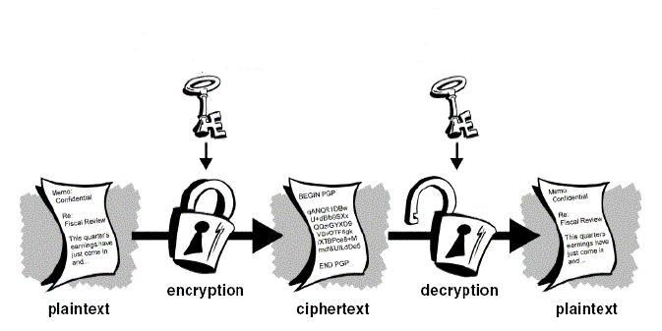
Basic Process

Slide 101
Non Encryption Ciphers
Stenography - The act of hiding data in plain site* (in another form). Such that nobody knows the secret data is there.
Does NOT encrypt data.
Example: Gif image, every 100 pixels are altered such they represent a number. This number is a value to be combined with every other 10 pixel values to be a message. (Your eyes wouldn’t detect the change in pixels)

Slide 102
BToC Confusion/Diffusion
Strong Ciphers have the following attributes
Confusion – commonly carried out through substitution
Diffusion – commonly carried out through transposition (mixing up characters in message)

Slide 103
BToC (key management)
Key lengths should be long enough to provide the necessary level of protection
Keys should be stored and transported in a secure means (why?)
Keys should be extremely random and use the full spectrum of the key space (why?)
Keys lifetime should correspond with the sensitivity of the data to be protected
(more)

Slide 104
BToC Key Management
The more the key is used the shorter it’s lifetime should be
Keys should be backed in case of emergency
Keys should be destroyed when their lifetime is at and end.

Slide 105
Methods of Encryption Overview
There are multiple “methods” of encryption
Symmetric
Asymmetric
Hybrids
Hashes (not really encryption, but no better place to put this) we are going to talk in detail about each of these

Slide 106
Symmetric Encryption
Idea same key is used to BOTH encrypt and decrypt data!

Slide 107
Symmetric Pros
Fast
Hard to break if using a large key size
Provides Confidentiality

Slide 108
Symmetric Cons
Keys must be shared
This is difficult to really do? How to you get a key to someone you want to talk to?
Requires secure mechanism to deliver keys
Number of keys becomes needed becomes crazy large as number of people involved increases
Does Not provide Authenticity or Non-repudiation

Slide 109
Types of Symmetric Ciphers
Block
Stream
Initialization Vectors
(more info on next pages)

Slide 110
Stream
Do not break into blocks, instead take one character of the message at a time.
The “key” is used with a “key stream generator” to create a stream of bits.
These bits are XORed with the plaintext to create cipher text
(more)

Slide 111

Stream Cipher
Keystream
Generator
Plaintext
XOR
Cyphertext

Slide 112
Stream Cipher considerations
Stream ciphers are hard work, better done in hardware*
“key stream generator” should not generate repeating patterns.
“key stream generator” should not product predictable output
“key stream generator” should not produce a key stream related to the key
The number of 0’s and 1s in the key stream should be about equal.

Slide 113
Initialization Vectors
Not a type of symmetric encryption. They are random values that are used to ensure that patterns are not created during the encryption process.
This is to allow you to generate different cipher text with the same plaintext and same key.
Used in both Stream and Block Ciphers
(Why would you want to do that?)

Slide 114
Specific Symmetric Cryptosystems
DES
Triple DES
AES
IDEA
Blowfish
RC4
RC5
RC6

Slide 115
DES general info
DES (Data Encryption Standard)
Read history on (on your own)
Understand that DES is the “Standard” DEA is the actual algorithm.
Retired when it became it was too easy to break.

Slide 116
DES
Symmetric algorithm
Block based algorithm
64 bit key but really only 56 bits ?!?
Divides the data into blocks and operates on them one at a time. These blocks are put through 16 rounds* (called an “S-box) of transposition (re-arranging) and substitution (changing) the order and type depends on the key.
There are 5 “modes” of DES

Slide 117
DES Modes (overview)
Electronic Code Book
Cipher Block Chaining
Cipher Feedback
Output Feedback
Counter Mode

Slide 118
ECB
Electronic Code Book – “regular” type of encryption, straight forward block by block encryption.
Given the same plain text and the same key, the resulting cipher text will always be the same. (which Is bad as we’ll see later)

Slide 119
Cipher Block Chaining
Tries to solve the problem of ECB mode.
For each block of data to encrypt, CBC uses not only the key but the results from the previous block.
For the first block (since we don’t have results from a previous block) we use an “Initialization Vector”
(see diagram on next page)

Slide 120
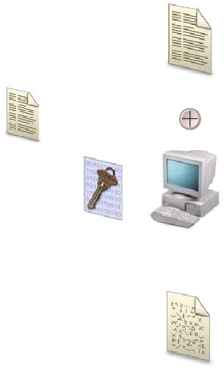
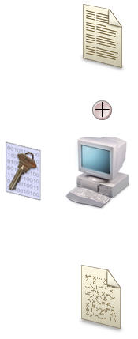
CBC diagram
CBC
Replaces IV
IV

Slide 121
Other DES Modes
Cipher Feedback, Output Feedback, Counter
I don’t think you’ll need to know much about these. I encourage you to read the sections in the book yourself, and let me know if you have any questions.

Slide 122
Triple DES
Like DES but uses 48 rounds* rather than DES’s 16 rounds.
Has 4 rounds
DES-EEE3 – 3 different keys: data is Encrypted, Encrypted, Encrypted (one key for each)
DES-EDE3 – 3 keys: Encrypted, Decrypted, Encrypted
DES- EEE2 – 2 keys, first and last operation use the same key
DES- EDE2 – 2 keys, first and last operation use the same key

Slide 123
AES
Advanced Encryption Standard – Developed to replace DES. There were multiple algorithms proposed to become “DES” the one chosen was called Rijndael.
Block cipher
Works well in software or hardware
Low memory requirements
Replaces DES
Supports block sizes of 128, 192, 256 bits

Slide 124
IDEA
International Data Encryption Algorithm
Block cipher
128 bit key
IDEA is faster than DES when implemented in software
Used in PGP (later)
patented

Slide 125
Blowfish
Block cipher
64 blocks of data
Key length can be 32 – 448
16 rounds of cryptographic functions
Unpatented, anyone can use it

Slide 126
RC4
Owned by “RSA”
Stream cipher
Variable key size
Used in SSL and in WEP (wireless) encryption
Simple, fast and efficient
Also called ARC4

Slide 127
RC5
Owned by RSA
Block cipher
Block sizes of 32, 64, or 128 bits
Key size can go up to 2048 bits
“rounds” are not fixed, can be up to 255

Slide 128
RC6
Same attributes at RC5, but modified to be faster
Owned by RSA
Block cipher
Block sizes of 32, 64, or 128 bits
Key size can go up to 2048 bits
“rounds” are not fixed, can be up to 255
faster than RC5

Slide 129
One Time Pad
A modification of a symmetric key system.
A “perfect cryptosystem”
Unbreakable if implemented properly
The key is a series of bits (0 and 1)
The plain text is converted to bits
The message is XORed with the pad/key to generated the cipher text (see next slide)
(more)

Slide 130
One Time Pad
1011 – plain text
0101 – pad
------ XOR
1110 – cipher text
In a one time pad you use a different key/pad each time you send a message

Slide 131
One Time Pad considerations
The pad must be used only one time
The pad must be shared by both sides.
The pad must be as long as the message
The pad must be securely distributed
The pad must be used up of truly random values

Slide 132
Asymmetric Encryption
Rather than use the same key for encryption and decryption, you use a different key for encryption and decryption
These keys are mathematically related to each other
These keys are called
Private Key
Public
(more)

Slide 133
Asymmetric Encryption
Public Key – given to everyone
Private Key – stays secret

Slide 134
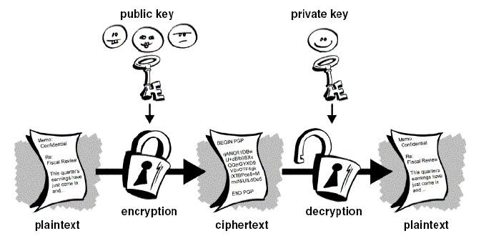
Asymmetric Encryption
Use public key to encrypt a message, private key can decrypt

Slide 135
Asymmetric Encryption
Private and Public keys can actually do the reverse, you can use the private key to encrypt plaintext then the resultant cipher text can only be decrypted by the corresponding “public key”
(see diagram on next page)

Slide 136
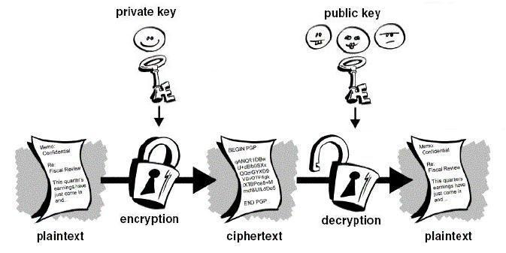
Asymmetric Encryption (signing)

Slide 137
Signing
This process of using a private key to encrypt something that can only be decrypted with your public key is call “signing” and is used for authentication and non-repudiation
If someone can read something you signed it proves that your private key was used.

Slide 138
One way function
An important concept in symmetric encryption is a “One way function”
A one way function is an operation that is faster to complete in one direction than the other.
Example: if you drop a glass it breaks instantly to “undo” this would take much more time.
Asymmetric algorithms use this concept
(more)

Slide 139
One way functions
With Asymmetric encryption, a message is encoded with a one way function. This function supplies a trapdoor* (knowledge of how to undo the one way function faster). The private key can be used to retrieve this “trapdoor” and then use the trapdoor to put things back in order.
Asymmetric algorithms use mathematical operations that are easier to do in one direction, than the other.

Slide 140
Asymmetric Pros/Cons
Pros
Key distribution is easy
Scalable due to that
Can provide authentication and non-repudiation
Cons
Very mathematically intense
Slow due to that

Slide 141
Specific Asymmetric Cryptosystems
Diffie-Hellman
RSA
El Gamal
Elliptic Curve Cryptosystem

Slide 142
Diffie Hellman
Developed to address shortfalls of key distribution in symmetric key distribution.*
Enables two people to receive a symmetric key securely without a previous relationship*
Algorithm is based on “difficulty of calculating discrete logarithms in a finite field”* (I really don’t know what this means ;)
Vulnerable to “man in the middle” attacks* (pg 707)

Slide 143
RSA
Can be used for digital signatures, key exchanges*, and encryption
Security comes from the difficulty of factoring larges numbers.
Private and Public keys are functions (results of mathematical operations) of large prime numbers.

Slide 144
El-Gamal
Used for digital signatures, encryption, and key exchange.
based on calculating discrete logarithms in a finite field
Actually an extension of Diffie-Hellman
Slowest of all the asymmetric algorithms we will discuss.

Slide 145
Elliptic Curve Cryptosystem
Used for digital signatures, encryption and key distribution
The fastest asymmetric algorithm that we discuss*
Deals with discrete logarithms of elliptic curve*.
Because it’s fast and easy used on devices with limited resources* (example: cell phones)

Slide 146
Hybrids
Hybrids cryptosystems use both Asymmetric and symmetric key cryptosystems.
Use a Asymmetric system to encrypt a key to a symmetric key system. (i.e. to distribute the key).
The Symmetric key is used to actually perform the encryption.
This key is called a “session key”* and is only used for the current conversation.

Slide 147
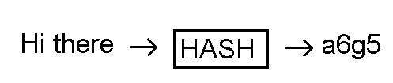
Hashes
A mathematical function that takes variable length input and produces a fixed length string.

Slide 148
Hash
Since hashes take any length input and produce a fixed output, there will be multiple inputs that produce the same output, this is called a collision*.
A good hash function should not make it predictable on how to “force” a collision. Otherwise you could create a message what would generate the same hash as another (why is this bad?)
(more)

Slide 149
Hash
Provide integrity, not confidentiality or authentication
Hashes are vulnerable to man in the middle attacks (how)

Slide 150
HMAC
HMAC – uses a secret hey in combination to a hash algorithm to verify that a hash is not tampered with.
Rather than just doing the “hash algorithm” on the message, append your secret key to the message to create a new message and run the hash on the new message. The returned value is called a MAC (Message Authenticating Code)
(see diagram on next page)

Slide 151
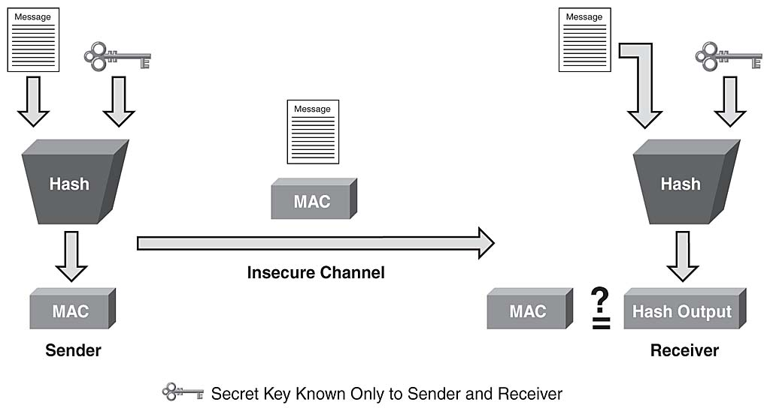
HMAC

Slide 152
HMAC
Provide integrity and data original authentication (how?)
Does not provide confidentiality
Does not provide specific person authentication (as keys are shared)

Slide 153
CBC-MAC
Message is encrypted with a symmetric block cipher the final block of cipher text is used as the MAC.
Sender sends the “plaintext” and the MAC.

Slide 154
CBC-MAC
Does not use a HASH
Provides authentication and integrity
Does not provide confidentiality

Slide 155
Specific Hash algorithms
MD2
MD4
MD5
SHA

Slide 156
MD2
Creates a 128 bit hash value, slower than MD4 and MD5

Slide 157
MD4
creates 128 bit hash value
Faster than MD2

Slide 158
MD5
Creates 128 bit hash value
More complex than MD2 and MD4
More secure, harder to determine how to force collisions for a specific message

Slide 159
SHA
Designed to be used with the Digital Signature Standard, (for use with digital signatures)
Creates 160 bit hash values
SHA = SHA-1
Alternate versions
SHA-256 = 256 bit hash values
SHA-385 = 384 bit hash values
SHA-512 = 512 bit hash values

Slide 160
Attacks against Hashes
Collisions – figure out how to create a message with the same hash value (collision)
Ex. “I’d like to buy 100 units of the widget” => DEADBEEF
What if I could make the messages “I’d like to buy 500 units of the widget” and have the same hash value “DEADBEEF” I can beat the integrity constraint
This is called a birthday attack

Slide 161
Digital Signatures
We can use Asymmetric Cryptography and Hashes. To provide message authenticity, and Integrity and Non-repudiation.. Cool!

Slide 162
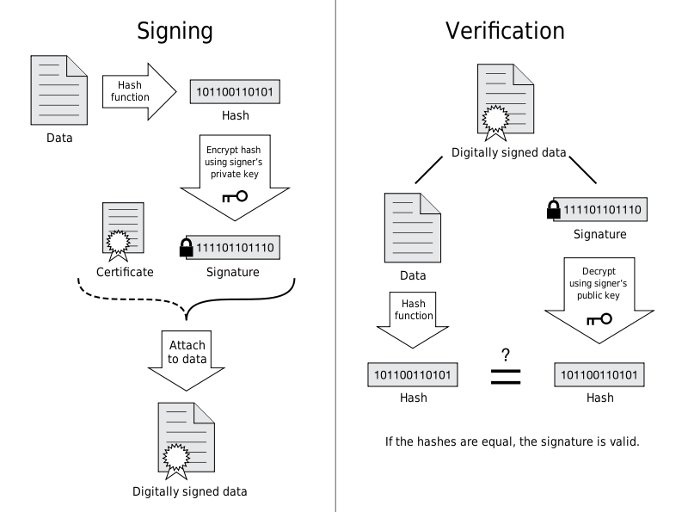
Digital Signature

Slide 163
Digital Signatures
How does this provide integrity?
How does this provide non-repudiation?

Slide 164
PKI Generic Idea
Public Key Infrastructure (PKI) is a series of programs, data formats, procedures, protocols, policies and public key (asymmetric) encryption. In order to provide secure communications for an organization.
Provides
Authentication
confidentiality
No repudiation
Integrity

Slide 165
PGP
Pretty Good Privacy
Released as a freeware e-mail security program.
First widespread use
Uses IDEA for confidentiality
Uses MD5 hash for integrity
Certificates for identification and authentication
Signed messages for non-repudiation
Based on a “web of trust” where people verify each other identity..no strict structure

Slide 166
QUESTION AND ANSWER That is week 1
?

